Slide 1


Video Games: Stats & Myths
Dataset: Web scraped from VGChartz Global Sales Game Database http://www.vgchartz.com/gamedb/
Why Video Games?
Fun for Everyone!
Lots of Misinformation!
Business Case: Can this dataset provide insight into what affects video game sales?
Best-Seller Fallacy
Time Plays Tricks
There Will Be Cake

Slide 2

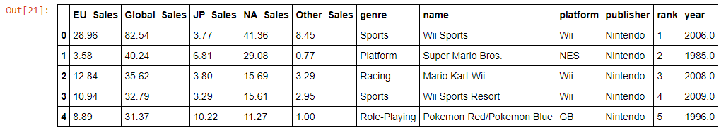
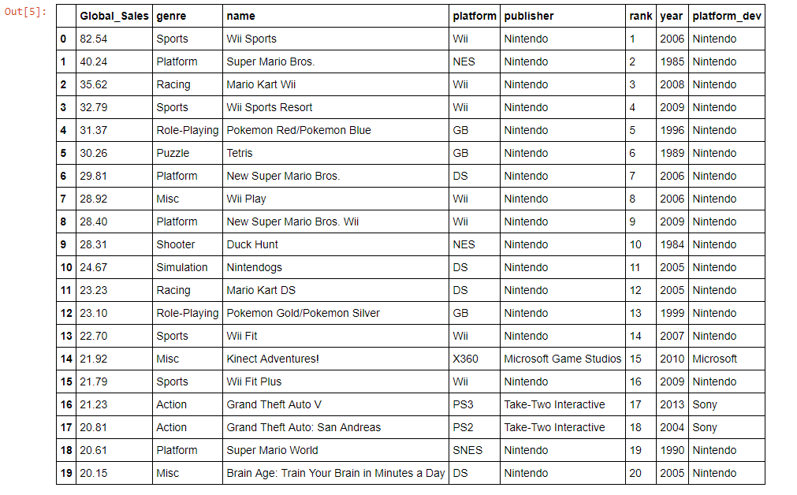

The Data
Notes
Sales are in millions
Games with at least 10,000 sales
16,697 titles included
Weaknesses in the Dataset
Only contains trackable sales
Genre data is ambiguous
No Metacritic Rating**
Observation
Nintendo’s got the power!
(85% Dominance)

Slide 3
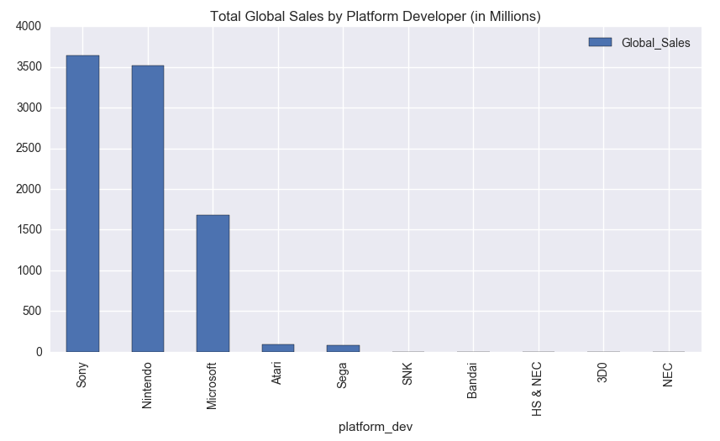

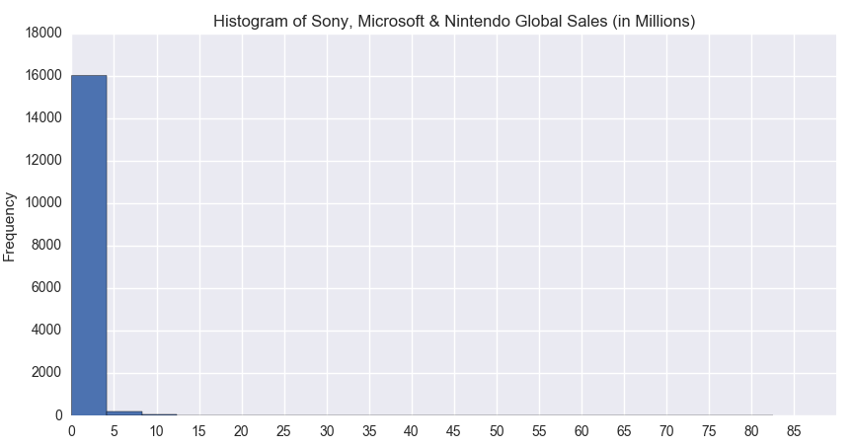

Best-Seller Fallacy
Big 3
Beware of Dragons and Skewed Distributions
Total Global Sales Relatively Similar
Big 3 Platform Devs
Distribution of data heavily skewed
Takeaway: Very few games become best-sellers

Slide 4
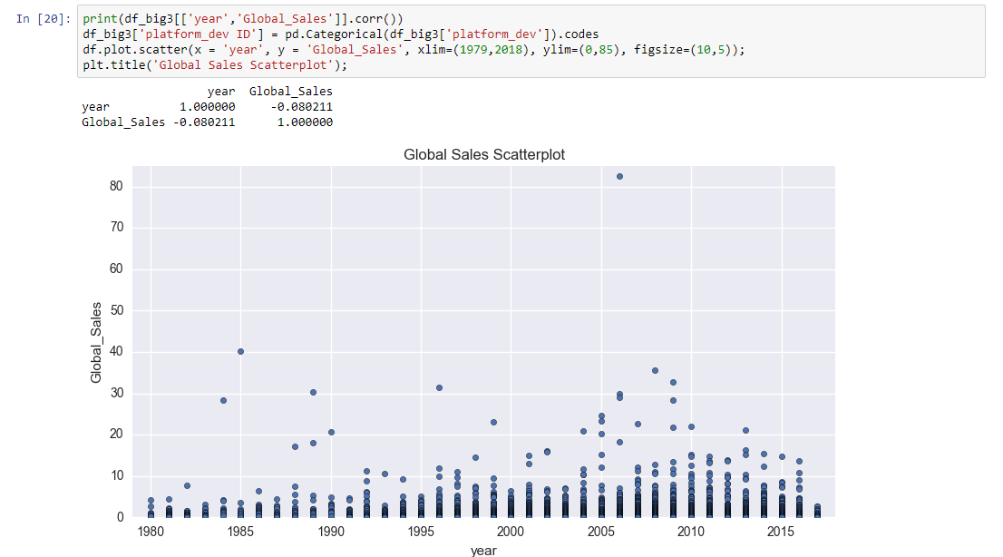

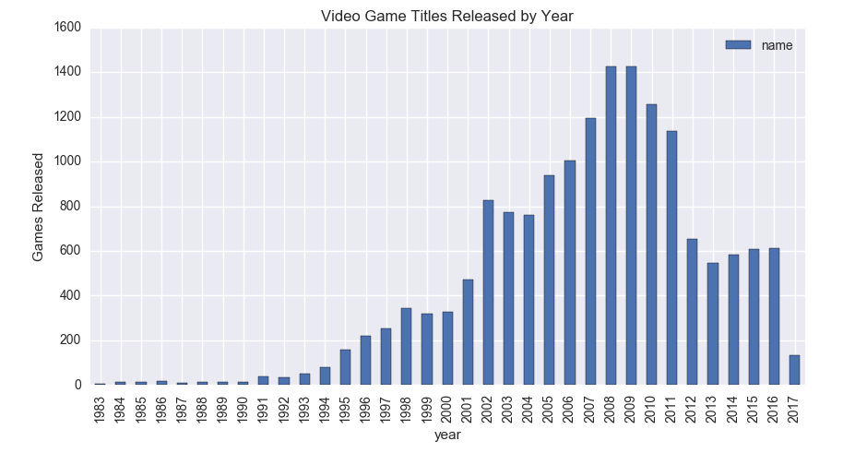







Time Plays Tricks
I used to be a data scientist like you…
* 2005-2010
* 2005-2010
Negligible correlation between year of release and global sales (~0)
Visual inspection confirms lack of a relationship
Higher density of well-selling games in *2005-2010 can be explained by larger volume of releases and increased market share
Takeaway: Obsolescence in the industry

Slide 5

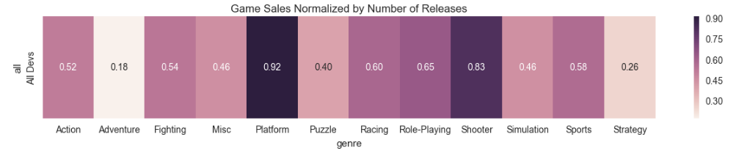
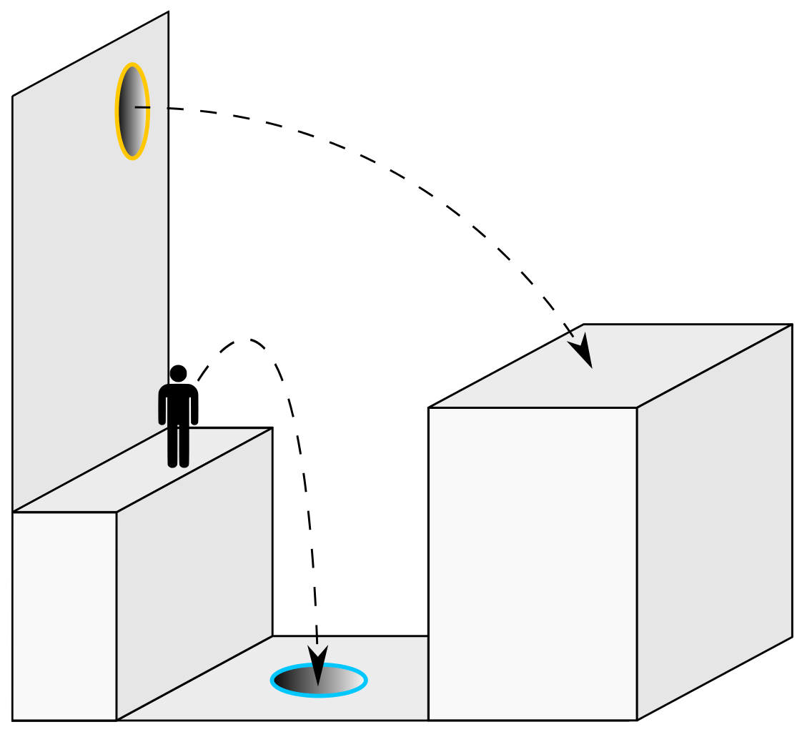

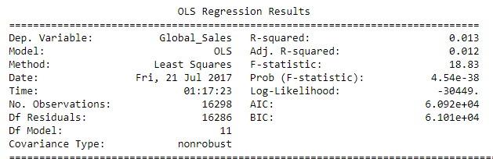

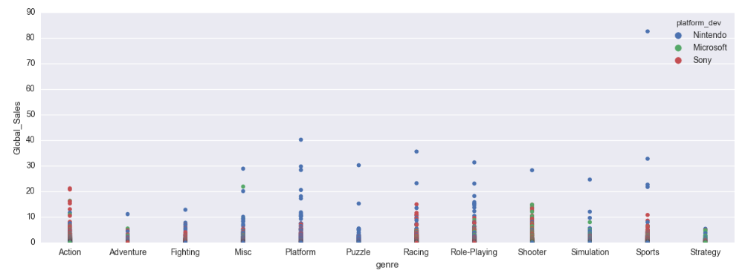
There Will Be Cake
The Cake is a Lie
Normalized sales suggest there may be a relationship between genre and global sales
OLS is a poor fit R-Squared ~ 0.013
Data is not visually linear
Takeaway: Developing a game for a popular genre does not imply that it will sell well.

Slide 6





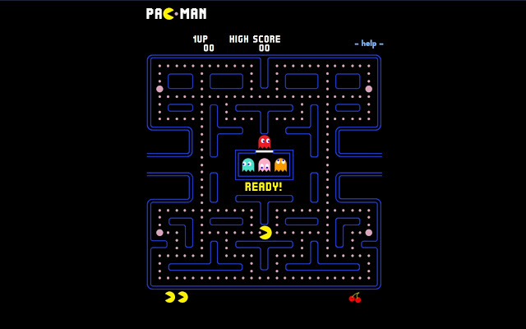








Conclusions
Heuristics may lead to incorrect assumptions and poor decision-making:
Data distribution reveals very few huge hits
Suspected correlations (Time, Genre) turned out to be non-existent
Too much uncertainty (noise) to identify relationships

